Slide 1
FYP Interim presentation
Michael lenghel
dt228

Slide 2
Automatic Stance Detection
The purpose of this project is to create an automatic stance detection algorithm which will detect the position of news companies and overall media in Ireland in regards to specific topics such as Brexit.
The domain area of this project investigates the optimal sourcing, cleaning and processing of Irish newspaper articles and linking both LDA topic modelling and sentiment analysis in order to dynamically create topics and calculate the sentiment scores of the respective news companies.

Slide 3


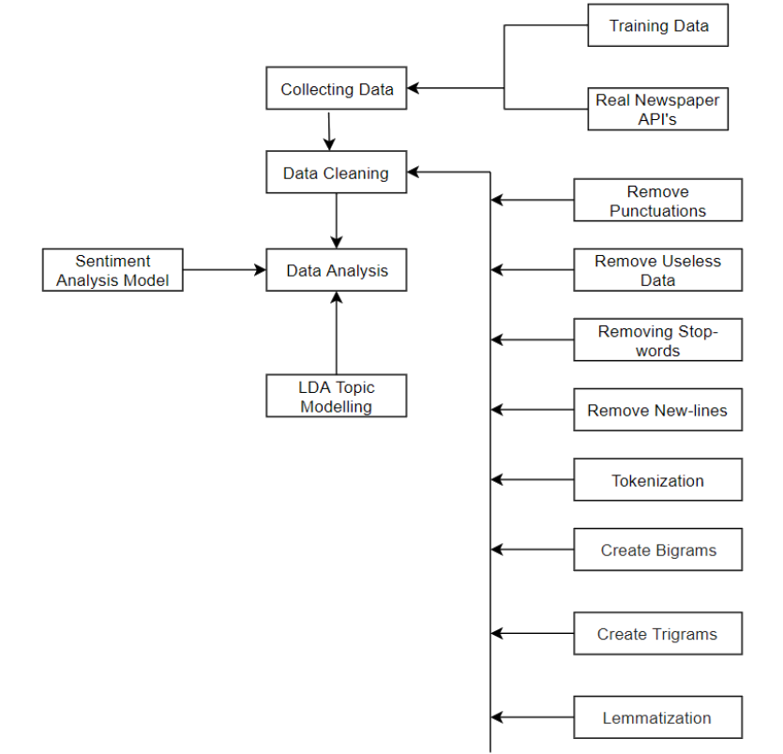
NLP Data Cleaning
The purpose of data cleaning within the context of sentiment and topic modelling is to break down the natural human language into what is easily understood by the model.
Data cleaning techniques that were implemented include removing punctuation, stop-words, tokenization, bigram creation and lemmatization.
The accuracy and efficiency of the models is highly dependent on the quality and variety of the data cleaning performed.

Slide 4
latent Dirichlet allocation (LDA) Topic Modelling
The purpose of LDA is to use word distribution within specific categories in order to link the most common words to imaginary topics.
Introducing Topic Modelling to this concept automates the production of these topics using machine learning.

Slide 5
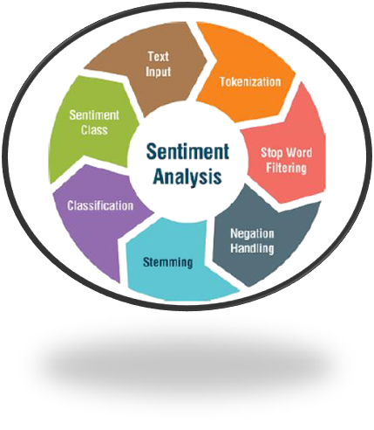
Sentiment Analysis
Sentiment analysis is the mechanism responsible for the understanding of each use of a word within a topic.
The implementation plan is to generate a score where 0 is negative, 0.5 is neutral and 1 is a positive representation of a topic.
An average will be calculated for each news company which will dictate their stance on the topic being searched.

Slide 6
System Design
The main development of this system focuses on the data scraping, data cleaning, training the sentiment and LDA Topic models and mapping the sentiment model to the created imaginary topics. Training the model to find specific topics will also be an area of complexity.
The system will be implemented in python with the application of a number of natural processing and machine learning libraries. Real time Irish newspaper articles will be sourced and scraped through API’s.

Slide 7
Technologies used
Python
AWS spell / AlchemyAPI to train large models
Various machine learning and NLP libraries such as NLTK, genism
Lexical databases such as WordNet

Slide 8
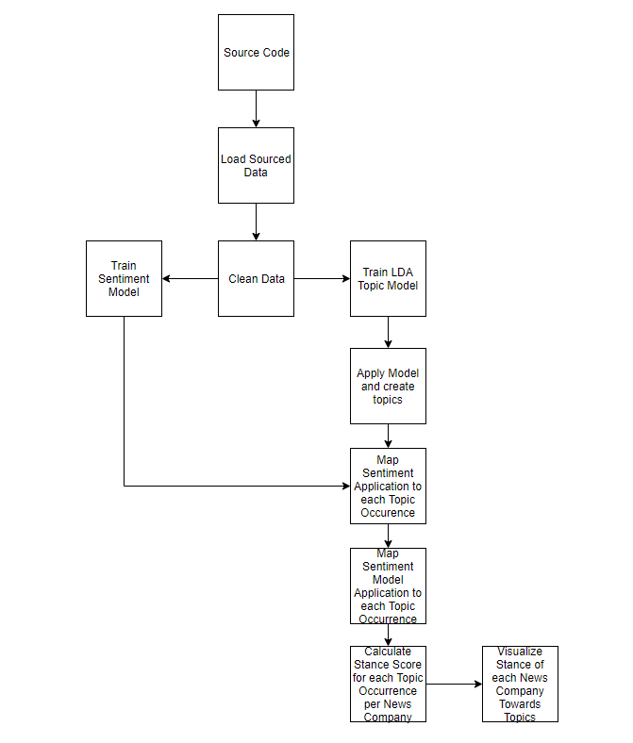
System Design

Slide 9
Research
Different methods of implementing stance detection were investigated in order to better understand what results current technology is capable of producing as well as the best approaches and their trade offs.
The research phase consisted of determining the correct approach and optimisations in order to build an accurate LDA Topic and sentiment model. Data sourcing, labelling and cleaning is also a big area of concern when it comes to creating accurate models.

Slide 10
Project Complexity
The main areas of complexity is within data cleaning, creating high quality topics using the LDA Topic model and applying accurate sentiment scores on each occurrence of a topic within the articles using the sentiment model.
Scale is also an area of concern as the model will need to create topics based on word frequency in over 10,000 articles and on each occurrence of a word within that topic a sentiment score will need to be computed.
The visualisation and evaluation of the topics with their sentiment scores across multiple news companies will also be a point of concern.

Slide 11
Project Complexity
Models that will be created:
LDA Topic Model.
Sentiment Topic Model.
Model Requirements:
Scraping thousands of categorized articles from Irish news companies
NLP data cleaning techniques such as Tokenization, bigrams, lemmatization, stop-words and many more.
Visualisation Required:
News company with list of topics and their representative stance scores.
Overall Media with list of topics and their representative stance scores.

Slide 12
Demo
The prototype implements a data cleaning algorithm using NLP techniques, the training of the LDA topic model using the “20 news groups data set” and a visualisation of the LDA model. The visualisation contains the words within each created topic as well as how closely linked each topic is to each other. Coherence and perplexity scores also demonstrate the quality of the topics.

Slide 13
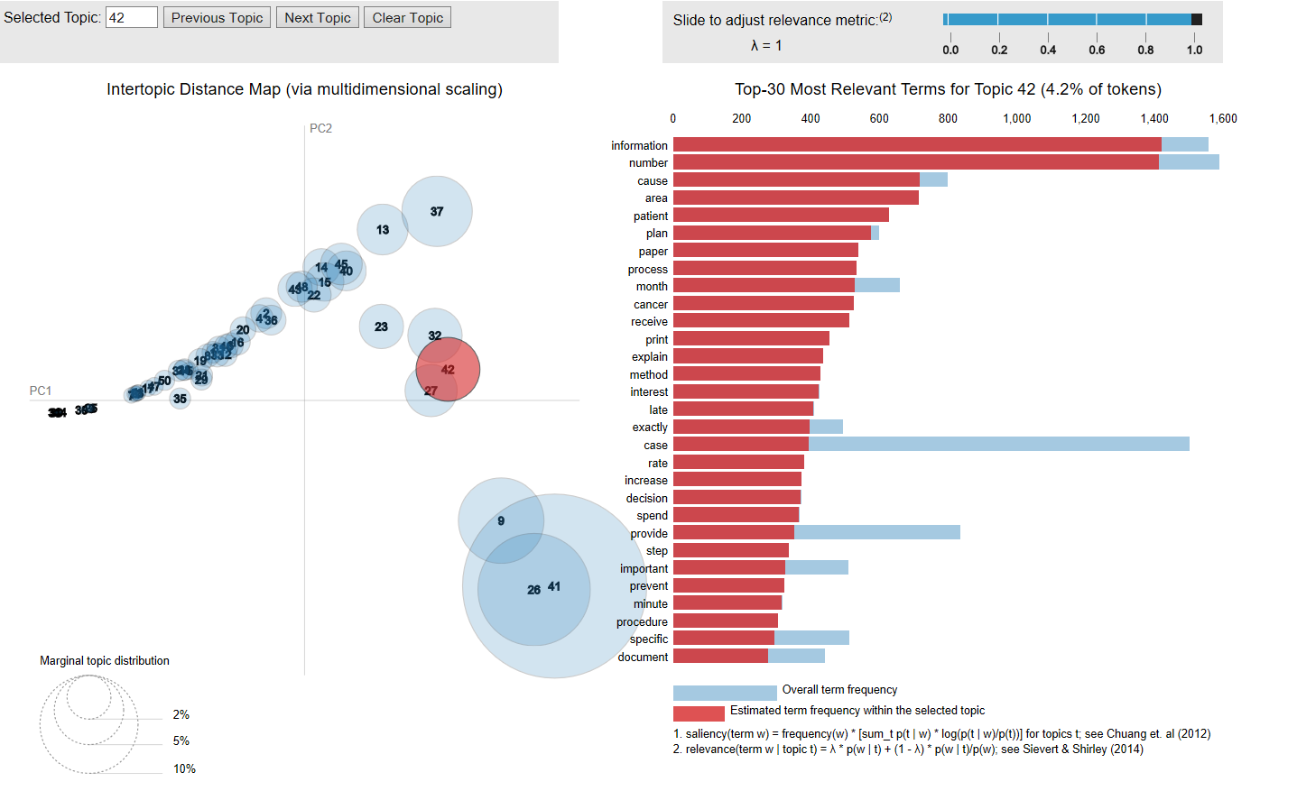
Demo Visualisation

Slide 14
Testing
Combination of:
White-Box
Black-Box
Grey-Box
Unit, Integration, System and Acceptance Testing

Slide 15
Future Work
Starting development phase of project
Start scraping real Irish newspaper articles within the last number of months
Automatically match imaginary topics created by LDA Topic model to real topics
Implement and train sentiment model with 0, 0.5 and 1 scores from negative to positive
Apply sentiment model on each sentence where a topic word occurred and correlate all occurrence to scores.

Slide 16

Questions

